Slide 1
Topic 5
Cost Assignment
Information for decision-making
Instructor:
Prof. Dr.B. Gültekin Çetiner
Website: http://elearning.drcetiner.com
drcetiner@gmail.com Prof. Dr. B. Gültekin Çetiner

Slide 2
Objectives
After studying this chapter, you should be able to
Describe Cost Assignment
Assign Direct and Indirect Costs
Explain Importance of Cost Assignment
Describe the Cost Centres
Describe Cost Allocations
Describe Steps for Cost Assignment to Objects
Describe two stage Cost Allocation in Traditional Costing
Describe Blanket Overhead term
Budgeted Overhead Rates
Under and Over-recovery of Overheads
drcetiner@gmail.com Prof. Dr. B. Gültekin Çetiner

Slide 3
Assignment of direct and indirect costs
• Direct costs can be specifically and exclusively identified with a given cost object – hence they can be accurately traced to cost objects.
• Indirect costs cannot be directly traced to a cost object – therefore assigned to cost objects using cost allocations.
• Cost allocations = process of assigning costs to cost objects that involve the use of surrogate rather than direct measures.
• Surrogates known as allocation bases or cost drivers.
• For accurate cost assignment,allocation bases should be significant determinants of the costs (i.e.cause-and-effect allocations).
drcetiner@gmail.com Prof. Dr. B. Gültekin Çetiner

Slide 4
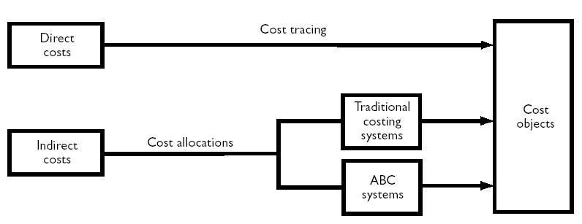
Assignment of direct and indirect costs
• Allocation bases that are not significant determinants of the costs are called arbitrary allocations (.result in inaccurate cost assignment).
• Traditional costing systems use arbitrary allocations to a significant extent whereas more recent (ABC)systems rely mainly on cause-and-effect allocations (see Figure below).
drcetiner@gmail.com Prof. Dr. B. Gültekin Çetiner

Slide 5
Different costs for different purposes
• Manufacturing organizations assign costs to products for:
Inventory valuation and profit measurement.
Providing information for decision-making.
• For inventory valuation and profit measurement the aim is to allocate costs between cost of goods sold (COGS)and inventories:
Accurate individual product costs are not required – only an accurate allocation at the aggregate level between inventories and COGS.
drcetiner@gmail.com Prof. Dr. B. Gültekin Çetiner

Slide 6
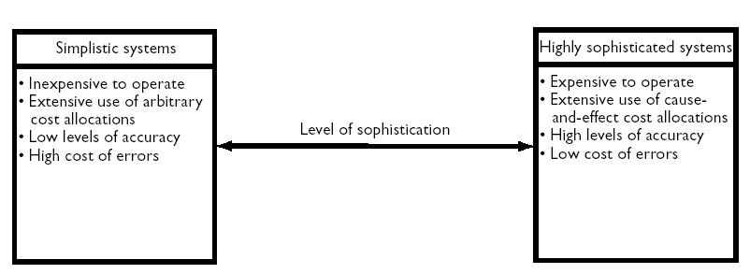
Different costs for different purposes
• For decision-making more accurate product costs are required.
• Different cost information is required for inventory valuation and decision-making but most companies use a single database and extract different costs for different purposes.
• Companies can choose to maintain their database using costing systems that vary on a continuum from simplistic to sophisticated (the choice should be based on costs versus benefits criteria – See Figure below).
drcetiner@gmail.com Prof. Dr. B. Gültekin Çetiner

Slide 7
Assigning indirect costs using blanket overhead rates
• Some firms use a single overhead rate (i.e.blanket or plant-wide) for the organization as a whole.
  Example
  Total overheads = £900 000
  Direct labour (or machine hours) = 60 000
  Overhead rate = £15 per hour
drcetiner@gmail.com Prof. Dr. B. Gültekin Çetiner

Slide 8
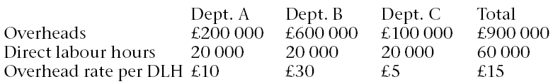

Assigning indirect costs using blanket overhead rates
Assume that the company has 3 separate departments and costs and hours are analysed as follows:
• Product Z requires 20 hours (all in department C)
Separate departmental rates should be used since product Z only consumes overheads in department C.
drcetiner@gmail.com Prof. Dr. B. Gültekin Çetiner

Slide 9
Assigning indirect costs using blanket overhead rates
• A blanket overhead rate can only be justified if all products consume departmental overheads in approximately the same proportions:
Product X spends 1 hour in each department and product Y spends 5 hours in each department (Both blanket and departmental rates would allocate £45 to X and £225 to Y).
• If a diverse range of products are produced consuming departmental resources in different proportions separate departmental (or cost centre)rates should be established.
drcetiner@gmail.com Prof. Dr. B. Gültekin Çetiner

Slide 10
Cost centre overhead rates
• Where a department contains a number of different centres (each with significant overhead costs)and products consume overhead costs for each centre in different proportions,separate overhead rates should also be
established for each centre within a department.
• See example on page 63 of text for an illustration.
• The terms cost centres or cost pools are used to describe alocation to which overhead costs are initially assigned.
• Frequently cost centres/cost pools will consist of departments but they can also consist of smaller segments within departments.
drcetiner@gmail.com Prof. Dr. B. Gültekin Çetiner

Slide 11
The two-stage allocation process
• To establish departmental or cost centre overhead rates a
two-stage allocation procedure is required:
Stage 1 – Assign overheads initially to cost centres.
Stage 2 – Allocate cost centre overheads to cost objects
(e.g.products)using second stage allocation bases/cost drivers.
drcetiner@gmail.com Prof. Dr. B. Gültekin Çetiner

Slide 12
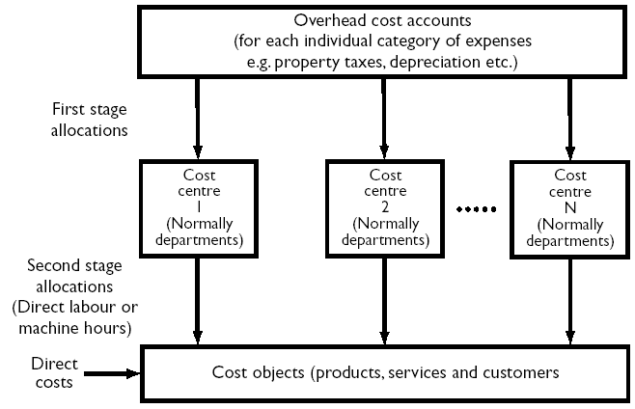
An illustration of the two-stage allocation process for traditional costing systems
drcetiner@gmail.com Prof. Dr. B. Gültekin Çetiner

Slide 13
Steps for the two-stage allocation process
Applying the two-stage allocation process requires the following 4 steps:
Assigning all manufacturing overheads to production and service cost centres.
Reallocating the costs assigned to service cost centres to production cost centres.
Computing separate overhead rates for each production cost centre.
Assigning cost centre overheads to products or other chosen cost objects.
drcetiner@gmail.com Prof. Dr. B. Gültekin Çetiner

Slide 14
Steps for the two-stage allocation process
Steps 1 and 2 comprise stage one and steps 3 and 4 relate to the second stage of the two-stage allocation process.
• Note that in the third stage above traditional costing systems mostly use either direct labour hours or machine hours as the allocation bases.
drcetiner@gmail.com Prof. Dr. B. Gültekin Çetiner

Slide 15
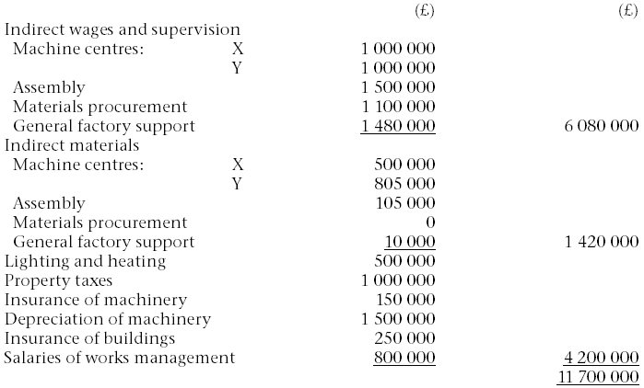
Illustration for Cost Centres
The annual overhead costs for a company which has three production centres and two service centres (Materials procurement and General factory support) are as follows:
drcetiner@gmail.com Prof. Dr. B. Gültekin Çetiner

Slide 16
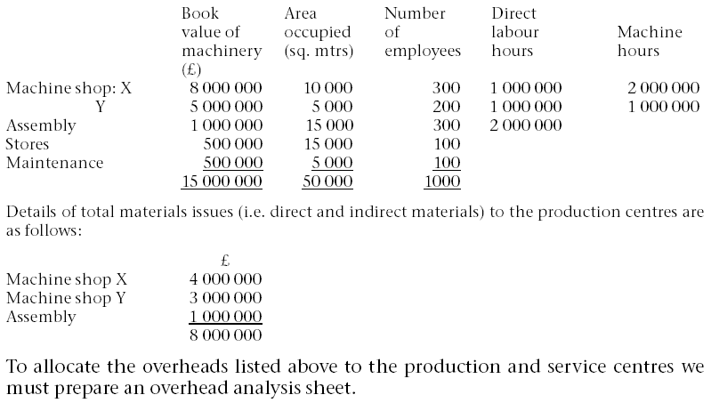
Illustration for Cost Centres
The following information is also available
drcetiner@gmail.com Prof. Dr. B. Gültekin Çetiner

Slide 17
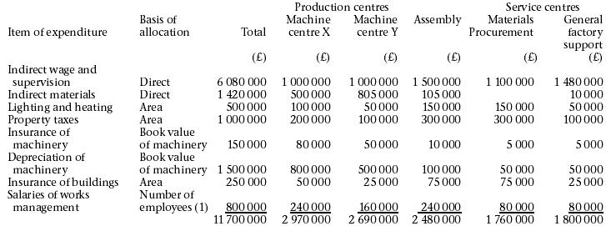
Illustration for Cost Centres
drcetiner@gmail.com Prof. Dr. B. Gültekin Çetiner

Slide 18
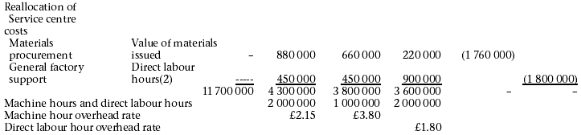
Illustration for Cost Centres
drcetiner@gmail.com Prof. Dr. B. Gültekin Çetiner

Slide 19
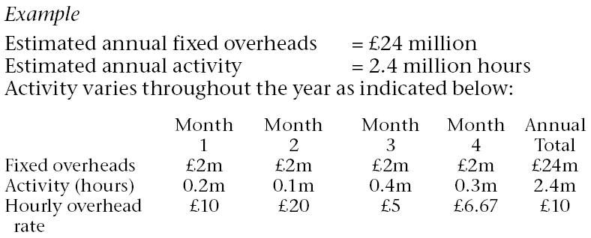
Budgeted overhead rates
• Actual overhead rates are not used because of:
1.Delay in product costs if actual annual rates are used.
2.Fluctuating overhead rates that will occur if actual monthly rates are used.
drcetiner@gmail.com Prof. Dr. B. Gültekin Çetiner

Slide 20
Budgeted overhead rates
• An estimated normal product cost based on average long-run activity is required rather than an actual product cost (which is affected by month-to-month fluctuations in activity).
• - therefore use estimates of overhead costs and activity over a long-
run period (typically one year)to compute overhead rates
(i.e.£10 per hour in the above example).
drcetiner@gmail.com Prof. Dr. B. Gültekin Çetiner

Slide 21
Under-and over recovery of overheads
•If actual activity or overhead spending is different from that used to compute the estimated overhead rates there will be an under or over recovery of fixed overheads.
Example
Estimated fixed overheads = £2 million
Estimated activity = 1 million direct labour hours
Overhead rate = £2 per DLH
drcetiner@gmail.com Prof. Dr. B. Gültekin Çetiner

Slide 22
Under-and over recovery of overheads
• Assume actual activity is 900 000 DLH ’s and actual overheads are £2 million:
Overhead allocated to products = £1.8 million
(900 000 × £2)
Under-recovery = £200 000
• Assume actual overheads are £1 950 000 and actual activity is 1 million DLH ’s:
Overhead allocated to products = £2 million
(1 million ×£2)
Over-recovery = £50 000
• External financial accounting principles (GAAP) require that under/over recoveries are treated as period costs.
drcetiner@gmail.com Prof. Dr. B. Gültekin Çetiner

Slide 23
Non-manufacturing overheads
• Financial accounting regulations specify that only manufacturing overheads should be allocated to products.
• Non-manufacturing costs should be assigned to products for decision-making (Particularly cost-plus pricing).
• Simplistic methods,such as using direct labour hours,or a percentage of total manufacturing cost,are frequently used as allocation bases with traditional systems.
  Example
  Manufacturing cost = £1 million
  Non-manufacturing overheads = £500 000
  Overhead rate = 50%of manufacturing cost
• Simplistic methods do not provide a reliable measure of the
non-manufacturing overheads consumed by products.
• ABC is advocated for providing a more accurate measure of
resources consumed by products.
drcetiner@gmail.com Prof. Dr. B. Gültekin Çetiner

